Slide 1

Pedestrian Safety

Slide 2
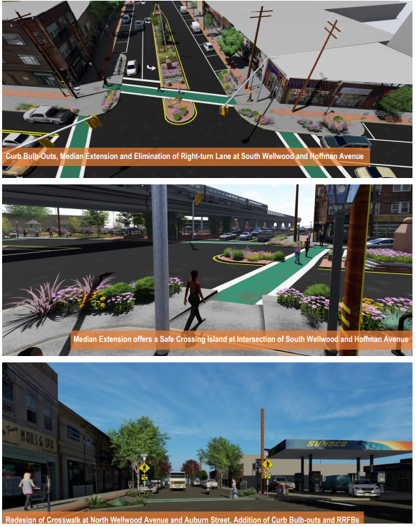
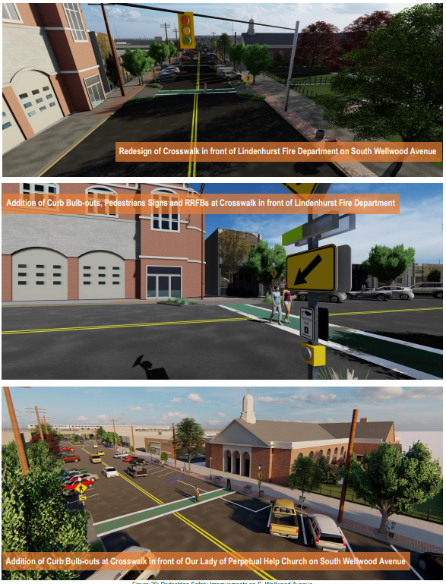

Bulb Outs
Worked with GPI on our Walkability Study and Downtown Master Plan and finalized the following concepts
Adding 5 Bulb Outs on Wellwood Ave with RRFB by Summer 2021 (Hopefully)
Funding Provided by the Suffolk County Jumpstart Program

Slide 3

Road Safety
Improvements

Slide 4
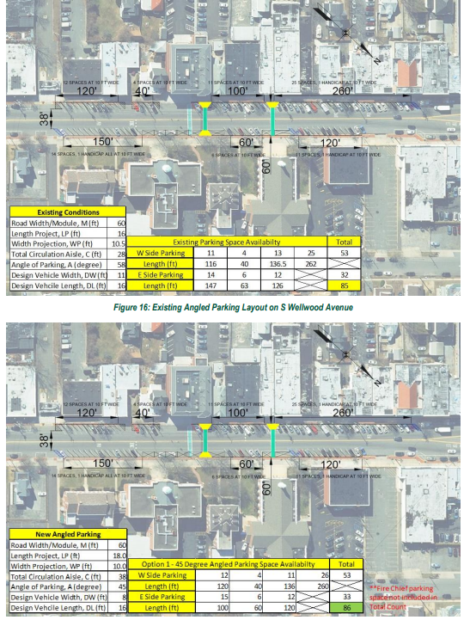
Road Safety Improvements
Historically we have had some issues with the parking angles on Wellwood Ave Parking Stalls which is currently at 60 degrees. i.e., accidents, trucks sticking into roadway
With GPI and County Jumpstart grant we are now adjusting our parking angles from 60 degrees to 45 degrees which will provide more line of site and improve safety
This project should be completed in Summer of 2021

Slide 5

Bike Rider Safety

Slide 6
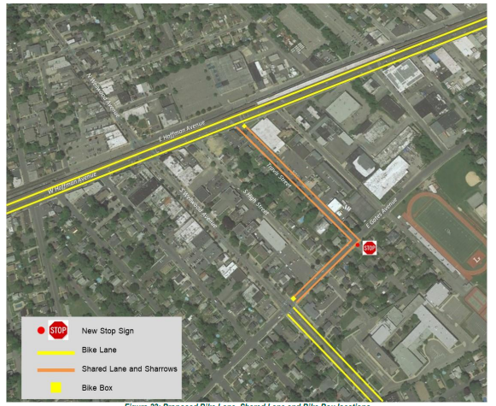
Bike Safety Routes
We are working to develop bike safety routes which will help dedicate lanes for bikers
Pedal Share
We are partnering with Pedal Share through the county to offer bikes to visitors and hopefully connect us to neighboring downtowns.

Slide 7
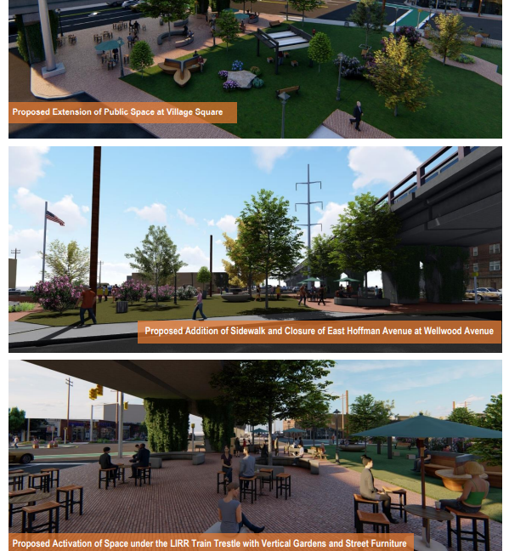
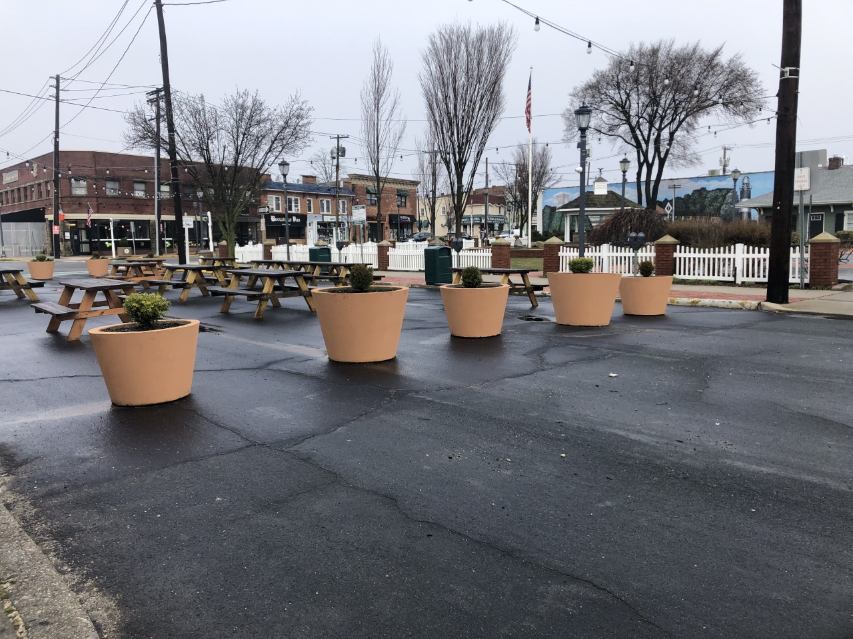
Park Expansion

Slide 8
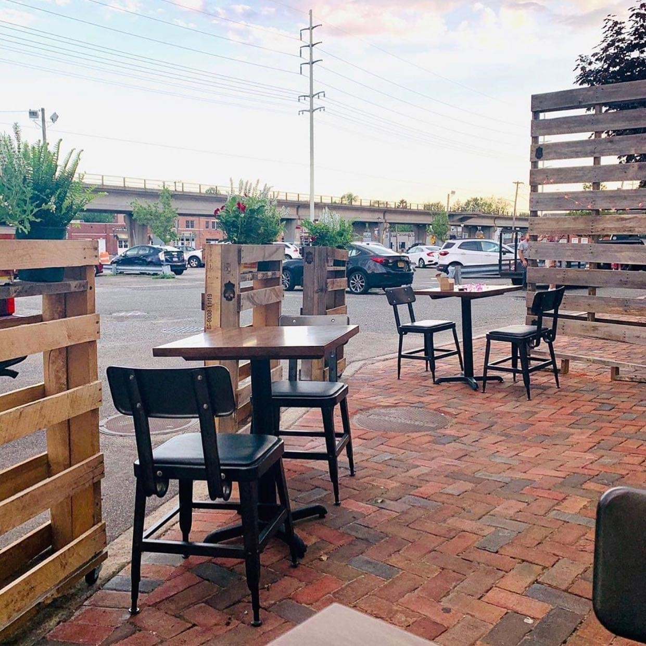
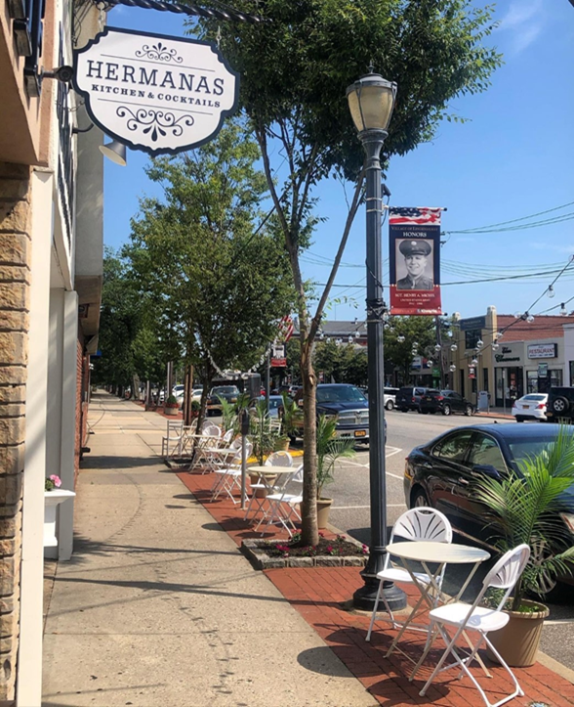
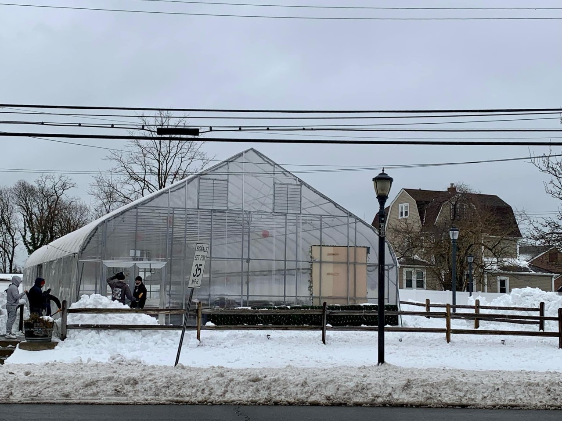
Getting People on the streets !

Slide 9
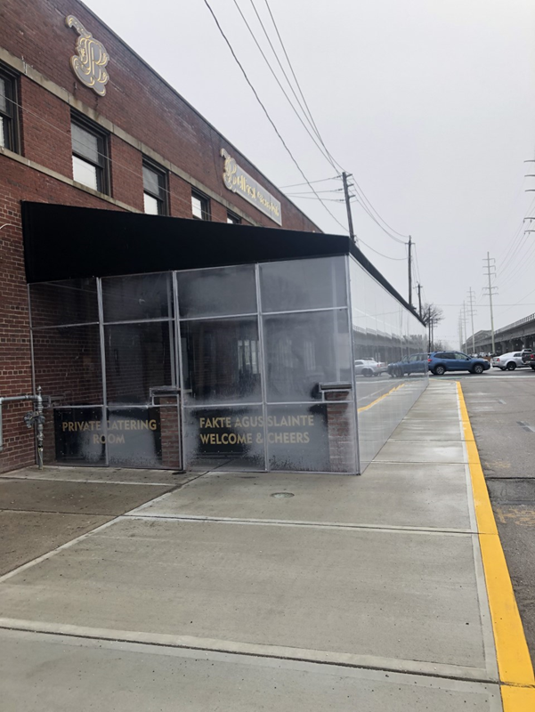
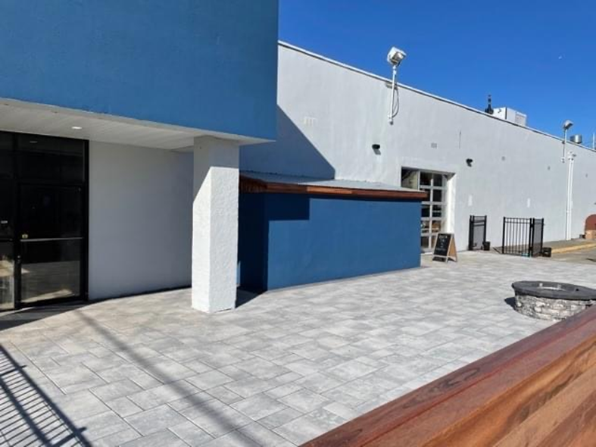
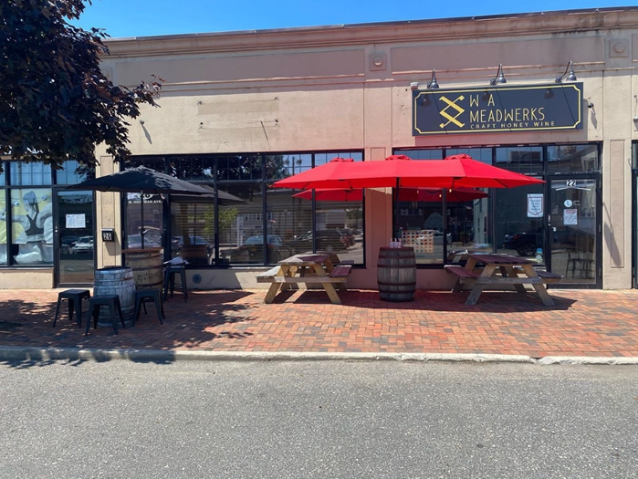
https://www.lindenhurstchamber.org/lindy-tv

